Slide 1
Hibernia-sino
Travel Insurance Company
- Interim report on system upgrades
- Group 15
Dong Yuehui
Zhang Lei
Zhang Jingyuan
Zhao Wenqi
Zhang Tianhui
Zhen Ziyang

Slide 2
Front and Back End Separation
Front End
Back End
Separation
Future
Asynchronous
The front end uses the vue framework
The back end uses the Spring boot framework
enable the front and rear to be developed synchronously to improve the productivity,
mitigate server load problems due to increased business traffic in the future
And through asynchronous loading, to ensure the response speed of the server

Slide 3
Log-in step
OAuth2
Cooperate with Spring Security framework to use OAuth2 to realize the authorization login service of third-party accounts
05
vue-i18n
We also use the VUE framework VUE -i18n plug-in to achieve multi - language switching.
04
iVIEW
01
Provide an input box for the user to enter a username and password
VUEx
03
02
Axios
Use the Vuex Store to implement responsive programming
After the post method in Axios is established and the data is sent to the back-end, spring security authenticates the user and implements the user authorization

Slide 4
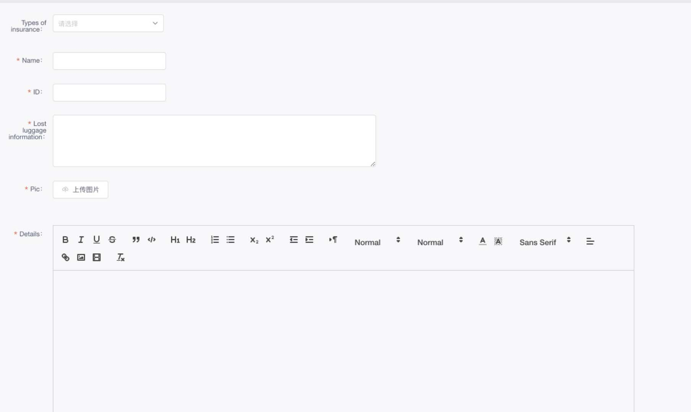
Customer form page

Slide 5

Log-in page

Slide 6
Customers' Step
Insurance type
submit
name
baggage information
Log in
details

Slide 7




Backend technology stack
vue-quill-editor
redis
01
Rich text editor :
submit complicate attachments
alleviate the pressure on servers and MySQL
03
02
Mybatis
axios
04
a persistence framework ：
decouple SQL statements from program code
sent data to the back end stored in MySQL

Slide 8
Employees' Step
Feedback to Customers
table form
application form data
SQL Database
agree/disagree
& reason
Log in
status info.

Slide 9
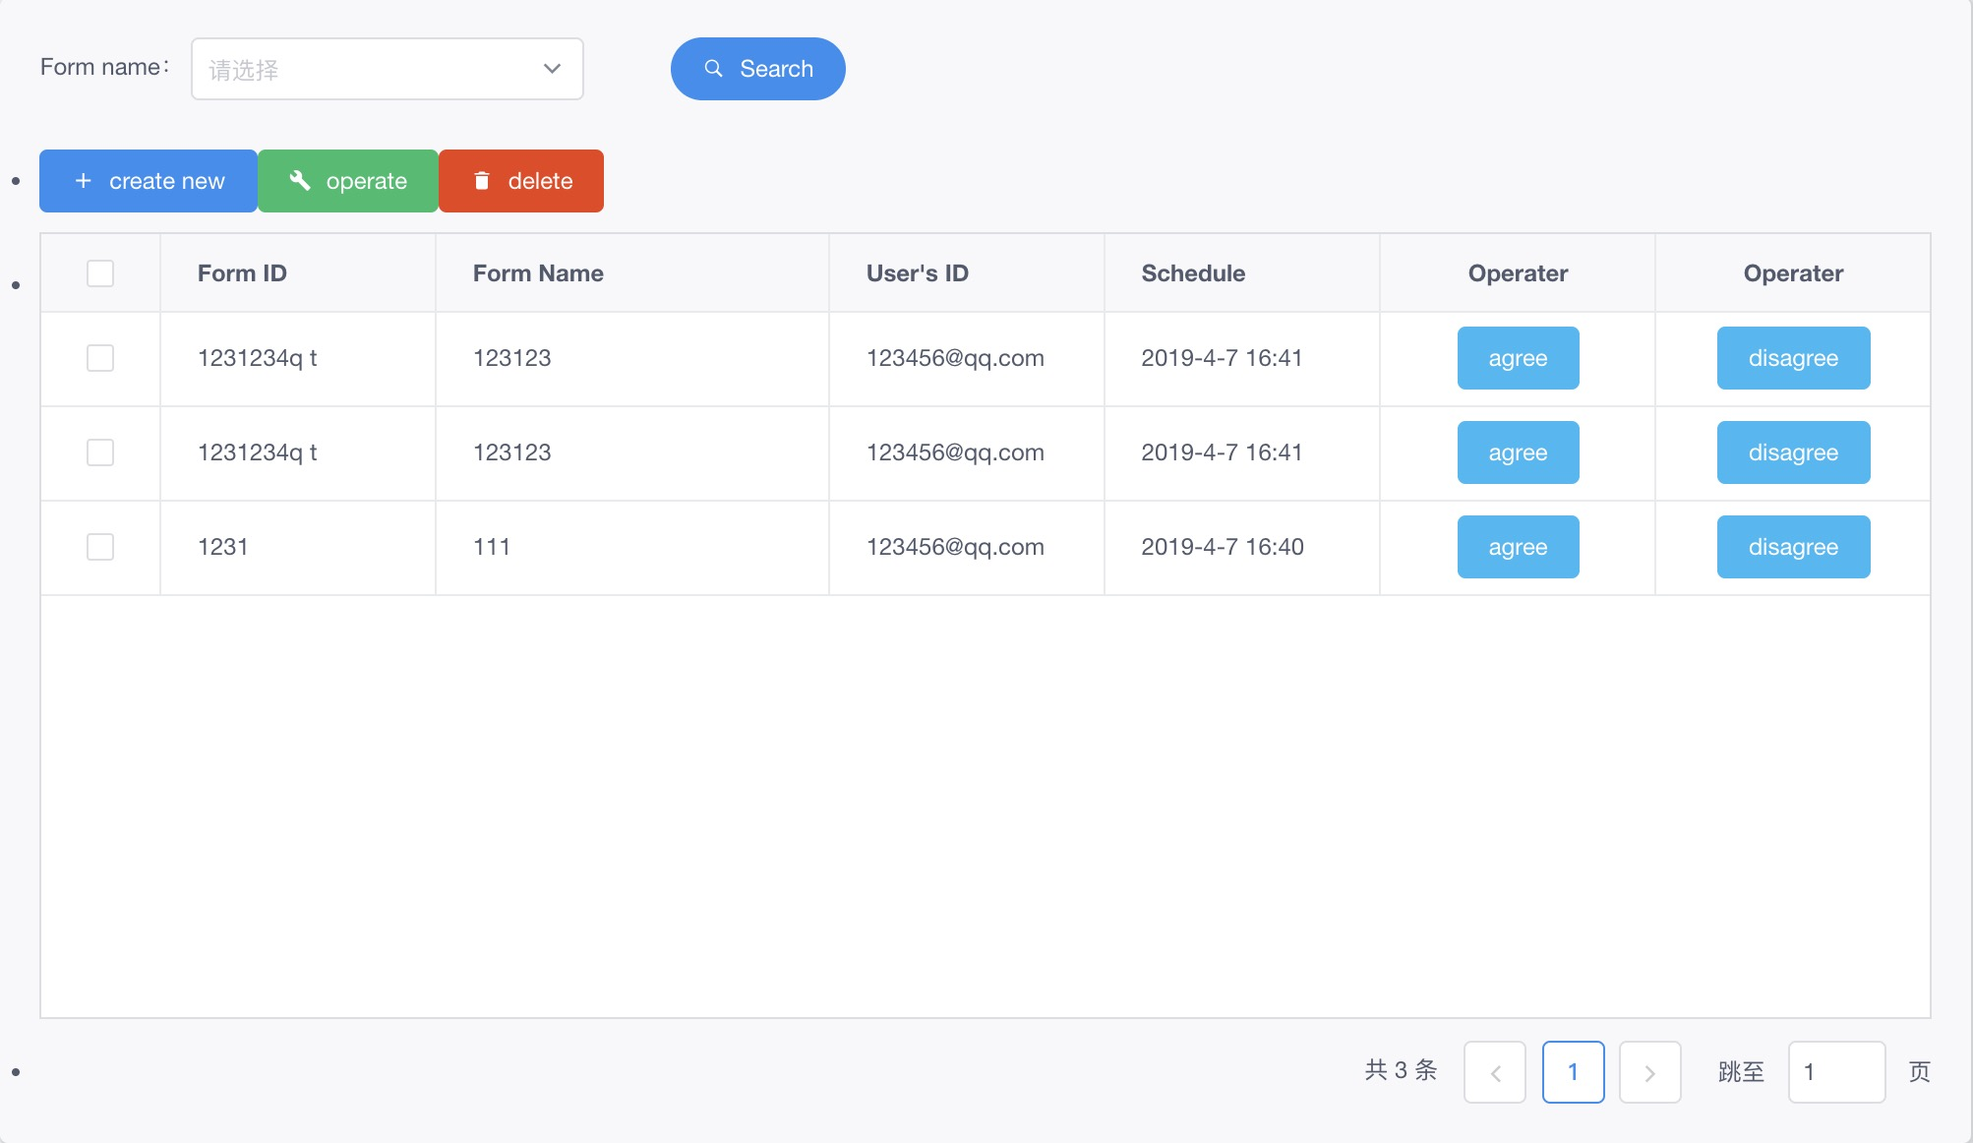
employees' UI

Slide 10
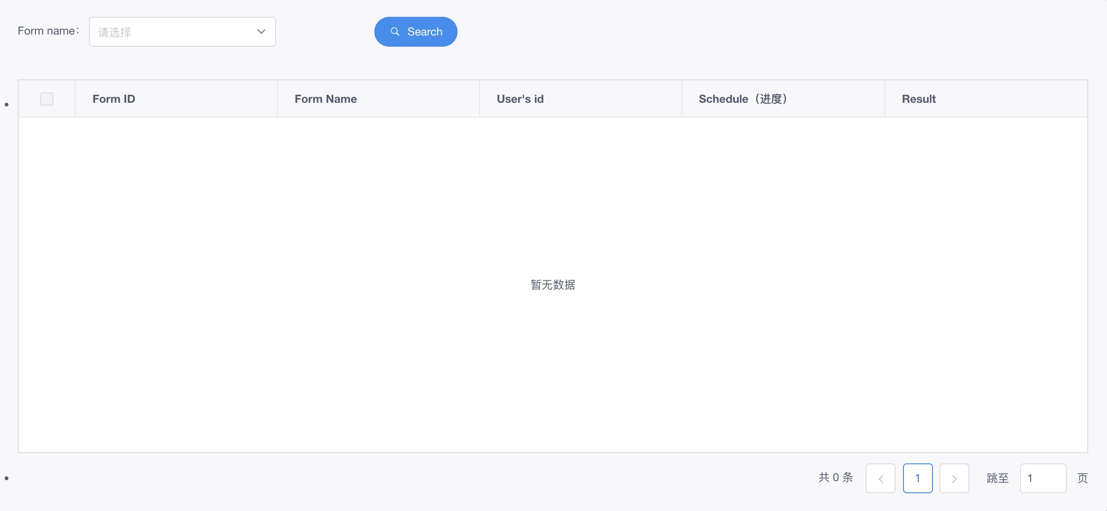
Results return to customers
The requested form is processed with a status property that is stored in the database.
Users can view approval results on the receipt page.

Slide 11
First iteration
START!
FINISH!
Week 2
Week 3
Week 4
Week 5
install the software configuration environment,
build the architecture
learn the relevant language grammar
analyzed the business requirements
make the whole plan.
document it,
produced basic webs design the back-end database.
Complete the web home page, landing page design
2、Complete user evaluation

Slide 12
Second iteration
We adjust the business logic according to the needs of customers
We have realized the addition, deletion and modification of user data.
What’s more ,User login and employee login are realized respectively
the logical aspect
Back-end part
:we completes user forms and the second beautification.
Also we achieved the Bilingual Functions of Web Pages.
front-end part
The basic front-end and back-end interaction tasks will be completed before the end of this week.

Slide 13
Third iteration
For example:
data caching, third-party login, and redirection of protected pages
complete the adaptation of the mobile phone.
the application will be put on the cloud server.
We will add some extra functions in the next 2 weeks.
delivered successfully
Week 9-10
Week 11
Week 12

Slide 14
QUESTIONS?

Slide 15
Front-end technology stack
VUE
VUEx
iVIEW
vue-quill-editor
vue-i18n

Slide 16
Front-end technology stack
VUEx
02
The vue framework of Store (warehouse) established by Vuex can realize responsive programming.
01
VUE
Through the focus view layer and plug-in of vue, we can deliver a website with more beautiful pictures and more complete functions for customers in the same time and cost.
03
iVIEW
By using the component library of iview, we can make more exquisite web pages in a shorter time and make real-time modifications according to customers' requirements
05
vue-i18n
In order to accommodate users in different countries, we use it to achieve multi-language switching.
04
vue-quill-editor
It provides a window for customers to upload text descriptions and picture attachments when making a claim

Slide 17
Back-end technology stack
Spring boot
Mybatis
Spring security
Oauth2
Redis

Slide 18
Back-end technology stack
Mybatis
02
Uncoupling SQL from program code
Facilitate unified management and optimization, improve the maintainability
01
Spring boot
Simplify the setup and development of spring applications
03
Spring security
It includes two parts: Authentication and Authorization
Its flexibility meets the typical requirements of our application development
05
Redis
Cache data
Alleviate the pressure on server and mysql when large-scale users access at the same time
04
OAuth2
Use OAuth2 with the Spring Security framework
To achieve the third party platform login

Slide 19
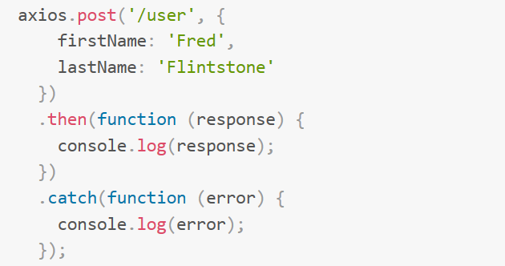
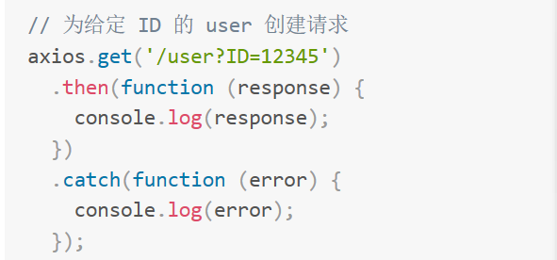
Interaction -- Axios
functional characteristics
1.XMLHttpRequests requests are sent in the browser
2.Send HTTP requests in node.js
3.Supporting Promise API
4.Intercept the request and response
functional characteristics
5.Transform request and response data
6.Automatically convert JSON data
7.Client support to secure against XSRF attacks

